Slide 1
PODCAST PLUS:A REDUX INSPIRED PODCAST APP WITH DYNAMIC THEMES FOR ANDROID
Vaishnavi.A
712522243701
Sreemathi.P
712522243026
Sahaya Riana.X
712522243024
Sweatha .N
712522243027

Slide 2
DESCRIPTION
Podcast Player App Features:
Vast Podcast Library: Access a huge selection of podcasts across various genres including news, comedy, storytelling, education, and more.
Easy Discovery: Browse trending, recommended, and new podcasts, or use advanced search filters to find specific episodes or shows.
Custom Playlists: Create and manage personalized playlists to keep all your favorite episodes organized and easily accessible.
Offline Mode: Download episodes for offline listening, perfect for when you're traveling or have limited data access.
Playback Controls: Control playback speed, skip ahead, rewind, set a sleep timer, and save bookmarks for your favorite moments.
Notifications: Get alerts when new episodes from your subscribed shows are released, ensuring you never miss out.
Cross-Device Sync: Sync your progress across devices, so you can seamlessly continue listening wherever you go.
User-Friendly Interface: Enjoy a clean, intuitive design that makes navigating, discovering, and managing podcasts effortless.
Automatic Episode Downloads: Set up auto-downloads for new episodes, so they’re ready for you to listen at any time.
Bookmark & Share: Easily bookmark key moments and share your favorite episodes with friends via social media or messaging apps.

Slide 3
Main Activity:
package com.example.podcastplayer
import android.content.Context
import android.media.MediaPlayer
import android.os.Bundle
import androidx.activity.ComponentActivity
import androidx.activity.compose.setContent
import androidx.compose.foundation.BorderStroke
import androidx.compose.foundation.Image
import androidx.compose.foundation.layout.*
import androidx.compose.foundation.rememberScrollState
import androidx.compose.foundation.verticalScroll
import androidx.compose.material.*
import androidx.compose.runtime.*
import androidx.compose.ui.Alignment
import androidx.compose.ui.Modifier
import androidx.compose.ui.graphics.Color
import androidx.compose.ui.res.painterResource
import androidx.compose.ui.text.font.FontWeight
import androidx.compose.ui.text.style.TextAlign
import androidx.compose.ui.unit.dp
import androidx.compose.ui.unit.em
import androidx.compose.ui.unit.sp
import com.example.podcastplayer.ui.theme.PodcastPlayerTheme

Slide 4
class MainActivity : ComponentActivity() {
override fun onCreate(savedInstanceState: Bundle?) {
super.onCreate(savedInstanceState)
setContent {
PodcastPlayerTheme {
// A surface container using the 'background' color from the theme
Surface(
modifier = Modifier.fillMaxSize(),
color = MaterialTheme.colors.background
) {
playAudio(this)
}
}
}
}
}
@Composable
fun playAudio(context: Context) {
Column(modifier = Modifier.fillMaxSize()) {
Column(horizontalAlignment = Alignment.CenterHorizontally, verticalArrangement = Arrangement.Center) {

Slide 5
Text(text = "PODCAST",
modifier = Modifier.fillMaxWidth(),
textAlign = TextAlign.Center,
color = Color(0xFF6a3ef9),
fontWeight = FontWeight.Bold,
fontSize = 36.sp,
style = MaterialTheme.typography.h1,
letterSpacing = 0.1.em
)
}
Column(modifier = Modifier
.fillMaxSize()
.verticalScroll(rememberScrollState())) {
Card(
elevation = 12.dp,
border = BorderStroke(1.dp, Color.Magenta),
modifier = Modifier
.padding(16.dp)
.fillMaxWidth()
.height(250.dp)
)
{
val mp: MediaPlayer = MediaPlayer.create(context, R.raw.audio)

Slide 6
Column(
modifier = Modifier.fillMaxSize(),
horizontalAlignment = Alignment.CenterHorizontally
) {
Image(
painter = painterResource(id = R.drawable.img),
contentDescription = null,modifier = Modifier
.height(150.dp)
.width(200.dp),
)
Text(
text = "GaurGopalDas Returns To TRS - Life, Monkhood & Spirituality",
textAlign = TextAlign.Center,
modifier = Modifier.padding(start = 20.dp, end = 20.dp)
)
Row() {
IconButton(onClick = { mp.start() }, modifier = Modifier.size(35.dp)) {
Icon(painter = painterResource(id = R.drawable.play),
contentDescription = ""
)
}
IconButton(onClick = { mp.pause() }, modifier = Modifier.size(35.dp)) {
Icon(
painter = painterResource(id = R.drawable.pause),
contentDescription = ""
)
}

Slide 7
Card(
elevation = 12.dp,
border = BorderStroke(1.dp, Color.Magenta),
modifier = Modifier
.padding(16.dp)
.fillMaxWidth()
.height(250.dp)
)
{
val mp: MediaPlayer = MediaPlayer.create(context, R.raw.audio_1)
Column(
modifier = Modifier.fillMaxSize(),
horizontalAlignment = Alignment.CenterHorizontally
) {
Image(
painter = painterResource(id = R.drawable.img_1),
contentDescription = null,
modifier = Modifier
.height(150.dp)
.width(200.dp)
)
Text(
text = "Haunted Houses, Evil Spirits & The Paranormal Explained | Sarbajeet Mohanty",
textAlign = TextAlign.Center,
modifier = Modifier.padding(start = 20.dp, end = 20.dp)

Slide 8
Row() {
IconButton(onClick = { mp.start() }, modifier = Modifier.size(35.dp)) {
Icon(
painter = painterResource(id = R.drawable.play),
contentDescription = ""
)
}
IconButton(onClick = { mp.pause() }, modifier = Modifier.size(35.dp)) {
Icon( painter = painterResource(id = R.drawable.pause),
contentDescription = ""
)
}
}
}
}
Card(
elevation = 12.dp,
border = BorderStroke(1.dp, Color.Magenta),
modifier = Modifier
.padding(16.dp)
.fillMaxWidth()
.height(250.dp)
)
{
val mp: MediaPlayer = MediaPlayer.create(context, R.raw.audio_3)

Slide 9
Column(
modifier = Modifier.fillMaxSize(),
horizontalAlignment = Alignment.CenterHorizontally
) {
Image(
painter = painterResource(id = R.drawable.img_3),
contentDescription = null,
modifier = Modifier
.height(150.dp)
.width(200.dp),
)
Text(
text = "Tantra Explained Simply | Rajarshi Nandy - Mata, Bhairav & Kamakhya Devi",
textAlign = TextAlign.Center,
modifier = Modifier.padding(start = 20.dp, end = 20.dp)
)
Row() {
IconButton(onClick = { mp.start() }, modifier = Modifier.size(35.dp)) {
Icon(
painter = painterResource(id = R.drawable.play),
contentDescription = ""
)
}
IconButton(onClick = { mp.pause() }, modifier = Modifier.size(35.dp)) {
Icon(
painter = painterResource(id = R.drawable.pause),

Slide 10
contentDescription = ""
)
}
}
}
}
Card(
elevation = 12.dp,
border = BorderStroke(1.dp, Color.Magenta),
modifier = Modifier
.padding(16.dp)
.fillMaxWidth()
.height(250.dp)
)
{
val mp: MediaPlayer = MediaPlayer.create(context, R.raw.audio_4)
Column(
modifier = Modifier.fillMaxSize(),
horizontalAlignment = Alignment.CenterHorizontally
) {
Image(
painter = painterResource(id = R.drawable.img_4),
contentDescription = null,
modifier = Modifier
.height(150.dp)
.width(200.dp),
)

Slide 11
Text(
text = "Complete Story Of Shri Krishna - Explained In 20 Minutes",
textAlign = TextAlign.Center,
modifier = Modifier.padding(start = 20.dp, end = 20.dp)
)
Row() {
IconButton(onClick = { mp.start() }, modifier = Modifier.size(35.dp)) {
Icon(
painter = painterResource(id = R.drawable.play),
contentDescription = ""
)
}
IconButton(onClick = { mp.pause() }, modifier = Modifier.size(35.dp)) {
Icon( painter = painterResource(id = R.drawable.pause),
contentDescription = ""
)
}
}
}
}
Card(
elevation = 12.dp,
border = BorderStroke(1.dp, Color.Magenta),
modifier = Modifier
.padding(16.dp)
.fillMaxWidth()
.height(250.dp)
)

Slide 12
{
val mp: MediaPlayer = MediaPlayer.create(context, R.raw.audio_5)
Column(
modifier = Modifier.fillMaxSize(),
horizontalAlignment = Alignment.CenterHorizontally
) {
Image(
painter = painterResource(id = R.drawable.img_5),
contentDescription = null,
modifier = Modifier
.height(150.dp)
.width(200.dp),
)
Text(
text = "Mahabharat Ki Poori Kahaani - Arjun, Shri Krishna & Yuddh - Ami Ganatra ",
textAlign = TextAlign.Center,
modifier = Modifier.padding(start = 20.dp, end = 20.dp)
)
Row() {
IconButton(onClick = { mp.start() }, modifier = Modifier.size(35.dp)) {
Icon(
painter = painterResource(id = R.drawable.play),
contentDescription = ""
)
}

Slide 13
Android.xml:
<?xml version="1.0" encoding="utf-8"?>
<manifest xmlns:android="http://schemas.android.com/apk/res/android"
xmlns:tools="http://schemas.android.com/tools">
<application
android:allowBackup="true"
android:dataExtractionRules="@xml/data_extraction_rules"
android:fullBackupContent="@xml/backup_rules"
android:icon="@drawable/podcast_icon"
android:label="@string/app_name"
android:supportsRtl="true"
android:theme="@style/Theme.PodcastPlayer"
tools:targetApi="31">
<activity
android:name=".RegistrationActivity"
android:exported="false"
android:label="@string/title_activity_registration"
android:theme="@style/Theme.PodcastPlayer" />
<activity
android:name=".MainActivity"
android:exported="false"
android:label="@string/title_activity_login"
android:theme="@style/Theme.PodcastPlayer" />
}

Slide 14
<activity
android:name=".LoginActivity"
android:exported="true"
android:label="@string/app_name"
android:theme="@style/Theme.PodcastPlayer">
<intent-filter>
<action android:name="android.intent.action.MAIN" />
<category android:name="android.intent.category.LAUNCHER" />
</intent-filter>
</activity>
</application>
</manifest>

Slide 15
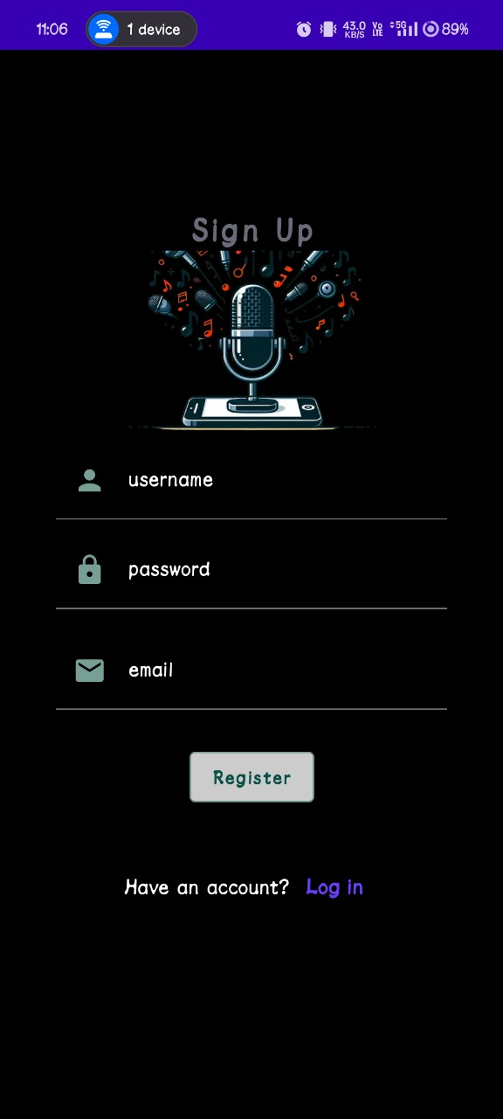
OUTPUT:

Slide 16
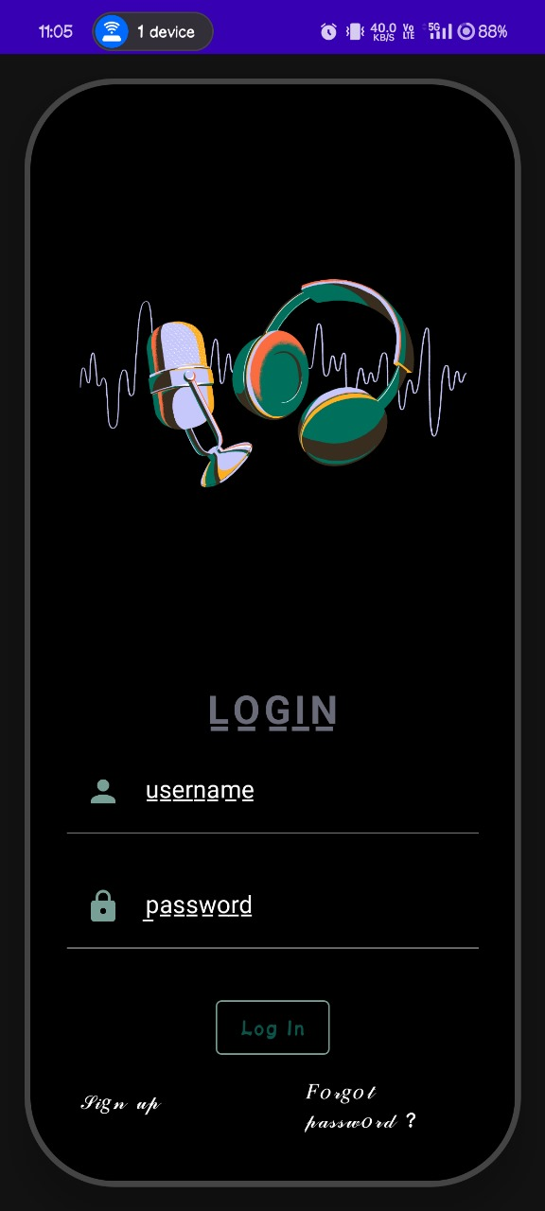

Slide 17
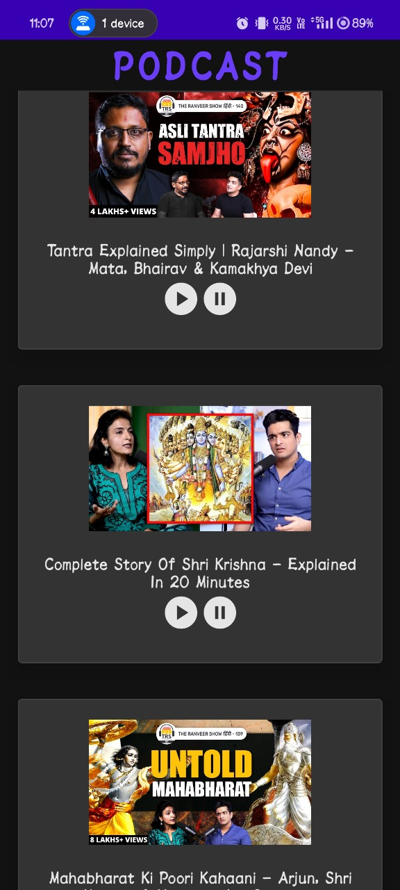

Slide 18
